Slide 1

Automobile Insurance Analysis
Vijay Kumar
Team ID: PTID-CDA-MAR-25-392
Batch: 18-NOV-24-CDA-BUN-040-WDM09-BAN

Slide 2
Introduction
Objective of the Project :
To investigate and interpret patterns in automobile insurance complaints submitted by consumers in New York.
To analyze how often different complaint types occur and how they vary across insurance companies and over time.
To evaluate the premiums written by companies over the years and interpret significant fluctuations.
To present an interactive dashboard comparing the performance of 5 selected insurance companies.
To suggest a specific company for improvement based on data insights.

Slide 3
Introduction
Source: NY State Department of Financial Services(DFS)
Dataset Features:
NAIC ID: Unique identifier for insurance companies.
Complaint Types: Upheld, Question of Fact and Not Upheld.
Premiums Written: Average of two years.
Filing Year: When the Complaint was closed.
Company Ratio: Upheld complaints per $1 million in premiums.
Company Rank: Based on Complaint performance.
Scope:
Covers multiple years of data.
Allows both time-series and cross-sectional company comparison.

Slide 4
Methodology
Data Import & Preprocessing:
Loaded CSV in Excel and Power BI. Cleaned, formatted numeric and date fields.
Created calculated fields: Total Complaints and Complaint Ratio.
Exploratory Data Analysis:
Visualized complaint trends over time. Segmented complaints by type and company.
Trend and Root Cause Analysis:
Built a slicer based dashboard for five company comparison. Included KPI’s, time trends, complaints distribution and ranking.
Insight Generation:
Compared performance, spotted red flags and suggested improvement.

Slide 5
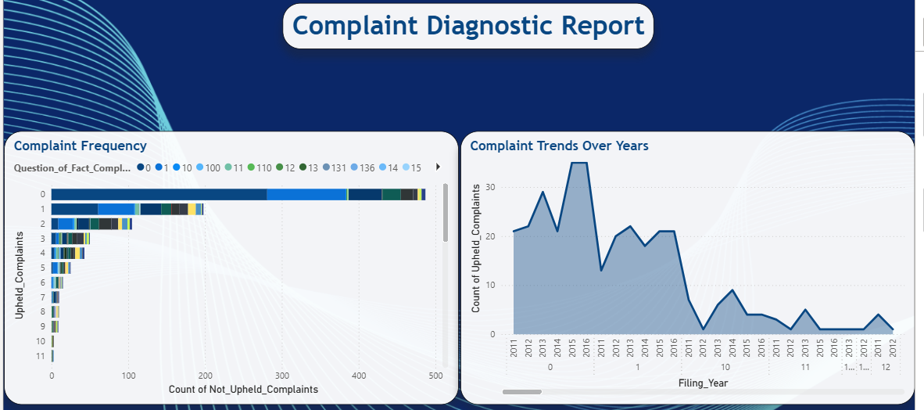
Complaint diagnostic report

Slide 6
Complaint diagnostic report
Findings on Complaint Patterns:
Upheld Complaints are the most significant since they represent validated consumer grievances.
Question of Fact Complaints often reflect misunderstanding or lack of documentation.
Not Upheld Complaints may still indicate poor communication or customer service.
Total Complaints serve as a strong indicator of public trust and operational efficiency.
Trends Over Time:
Certain years saw spikes due to delays in processing.
Companies with volatile complaint counts may lack consistent internal controls.

Slide 7
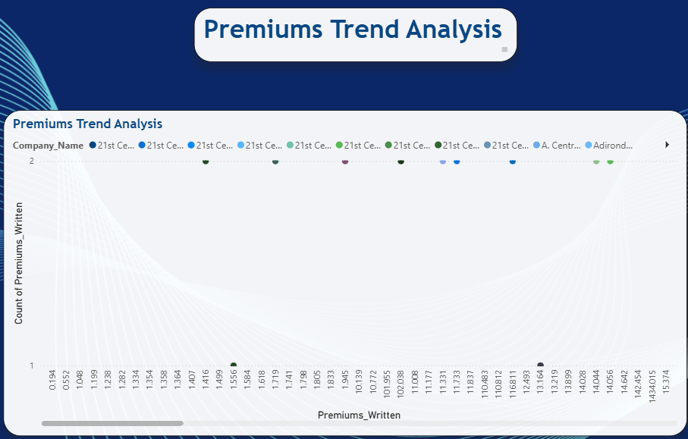
Premium Trends Analysis

Slide 8
Premium Trends Analysis
Premium Analysis:
Companies with rising premiums often have growing market share.
Sudden drops in premium values may result from Exit from NY market, Mergers or Acquisitions and Regulatory limitations.
Premiums may also increase in response to risk or inflation.
Findings:
Some companies increased premiums while reducing upheld complaints indicating operational improvement.
Others increased premiums but also faced more complaints suggesting service decline.

Slide 9
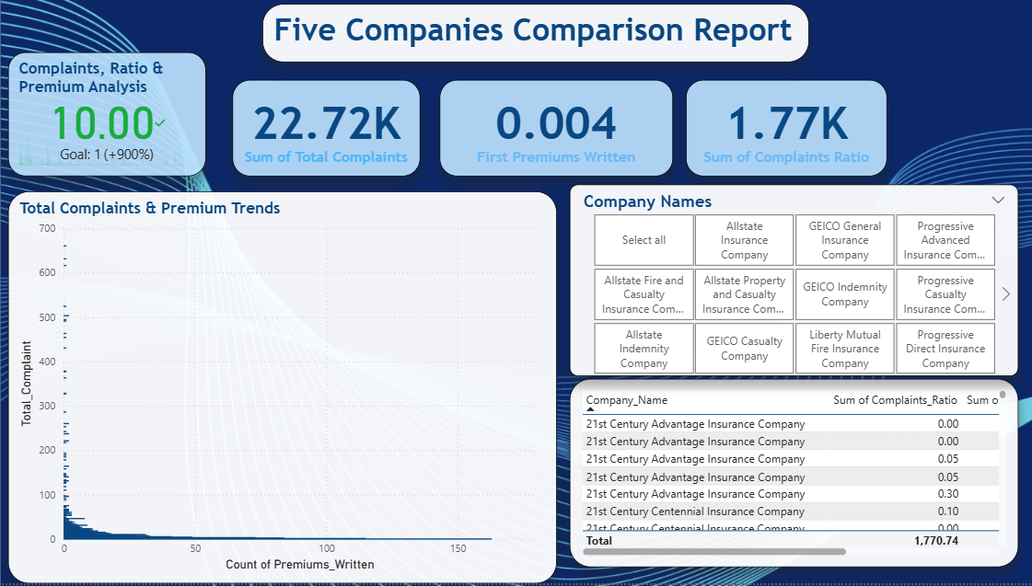
Company Comparison Dashboard

Slide 10
Company Comparison Dashboard
Dashboard Features:
Slicer – Selecting 5 Companies from full list.
KPI Cards – Total Complaints, Premiums Written, Complaint Ratio and Complaint Rank.
Bar Chart - Complaint types for each company, Line Chart – Complaint trend by year and Table – Complaints ratio and ranking.
Selected Companies:
1. GEICO
2. State Farm
3. Allstate
4. Progressive
5. Liberty Mutual
These companies were chosen for diversity in rank, complaint volume and premium size.

Slide 11
Insights & Recommendations
Best Performers:
Example – GEICO shows low complaint ratios with steadily rising premiums, indicating strong and operational consistency.
Needs Improvement:
Example – Liberty Mutual has a high upheld complaint count with inconsistent premium history, which may reflect weak claims handling or customer service gaps.
Insights:
Companies with consistently low complaint ratios and stable premiums are likely to have strong operational systems, effective customer service and proactive claim resolution practices.
High Complaint volumes, especially upheld ones, indicate a need for immediate internal audits, customer support re-evaluations and root cause analysis.

Slide 12
Insights & Recommendations
Complaint type analysis shows that non-renewals and claim delays are top issues companies should revise these processes to improve satisfaction.
Recommendations:
Digital Claim Processing – Automate and speed up claims lifecycle.
Customer Support Training – Reduce not upheld complaints due to misunderstanding.
Policy Transparency – Minimize non-renewal issues through better communication.
Use Predictive Analytics – To anticipate and prevent service failure triggers.
Develop interactive customer support channels to address pre-claim confusion, reducing complaint escalation.

Slide 13
Conclusion
The Volume and type of complaints differ significantly across companies, indicating varying levels of customer service, transparency and dispute resolution efficiency.
Upheld complaints are a critical indicator of genuine service failure and need urgent attention from insurers.
Complaint ratios, when normalized against premiums, allows fair comparisons, revealing that some companies with large market shares still maintain low complaint levels.
Premium trends provide a lens into company strategy steady growth often suggest market confidence, while volatility may reflect structural issues or market exits.

Slide 14
Thank You

